Slide 1

Web Based Machine Learning Automated Pipeline
A project submitted in partial fulfilment of the requirements for the degree of
Bachelor of ENGINEERING in Computer Engineering
by
Mahesh Manohar Sirsat
Roll- B212056
AjitKumar Vishwakarma Sharma
Roll- B212048
Aashish Shahi
Roll- B212047
Omkar Maruti Halgi
Roll - B211047
Under the guidance of
Mr. Sachin Sambhaji Patil
Assistant Professor
Department of Computer Engineering
Zeal College Of Engineering and Research
Narhe|Pune - 41
2022- 2023

Slide 2
Overview
Abstract
Literature Survey
Problem Statement
Methodology
System Architecture
Implementation
Result
Conclusion

Slide 3
Abstract
With the increasing volume, velocity, veracity, and variety of data, it has become critical to have efficient techniques and tools for managing and analyzing data in machine learning. Abstraction is a powerful concept that allows users to interact with machine learning algorithms without understanding their technical implementation details. In this project the user will provide the dataset in .csv format the dataset is then processed further to different machine learning preprocessing steps like removing unwanted columns, handling missing values, label encoding, outlier detection and removal, normalization, model building, model prediction, and the result can be downloaded as pdf, tracable pdf and CSV, this all processes gives a result of different model and their respective accuracy so that we can choose the best model for that particular dataset. tracable pdf will be containing all the timestamp of the processes done with their respective result, Apart from client-server model user is also provided a api so that all processes can be implemented in different platforms like c++, java, ruby etc. Overall, this paper highlights the critical role of abstraction in managing the complexity of data and machine learning algorithms, enabling more efficient and effective analysis of large and complex datasets.
Keywords—Dataset, Dataset Filtering, Client Server, Pdf Generation, Data Preprocessing.

Slide 4
Literature Survey
Paper No. | Name of paper | Author | Published Year
01(Base Paper) | A Review on Data Preprocessing Techniques Toward Efficient and Reliable Knowledge Discovery From Building Operational Data | Cheng Fan,Meiling Chen | 2021
02. | A Survey of Datasets, Preprocessing, Modeling Mechanisms and Simulation Tools Based on AI for Material Analysis and Discovery | Imran , Faiza Qayyum , Do-Hyeun Kim , Seon-Jong Bong , Su-Young Chi and Yo-Han Choi | 2022
03. | A survey on outlier explanations | Egawati Panjei | 2022
04. | Data pre-processing and data augmentation techniques | MWAMBA KASONGO DAHOUDA AND INWHEE JOE | 2022
05. | Missing Data Analysis in Regression | C. G. Marcelino, G. M. C. Leite, P. Celes & C. E. Pedreira | 2022

Slide 5
Problem Statement
The increasing availability of data and advancements in machine learning algorithms have led to the proliferation of machine learning models in various domains. However, data preprocessing is a critical step in the machine learning pipeline that can significantly affect the performance of the resulting models. Many data preprocessing techniques and tools exist, but they often require extensive domain knowledge and programming skills. Moreover, existing tools may not be readily accessible to users who lack technical expertise. Therefore, there is a need for a user-friendly, web-based machine learning preprocessing tool that can automate and simplify the data preprocessing process for users with limited technical knowledge.
This tool should be able to handle various data formats, provide a range of preprocessing techniques, and optimize the data preprocessing workflow to enable users to focus on developing better machine learning models

Slide 6
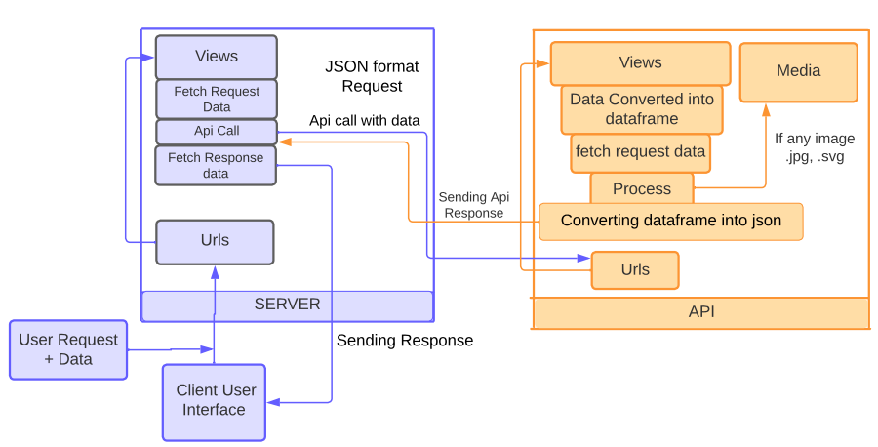
Methodology

Slide 7
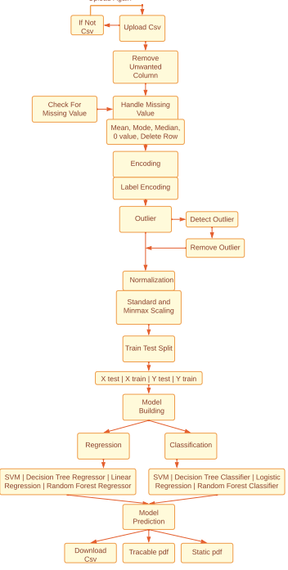
System Architecture

Slide 8
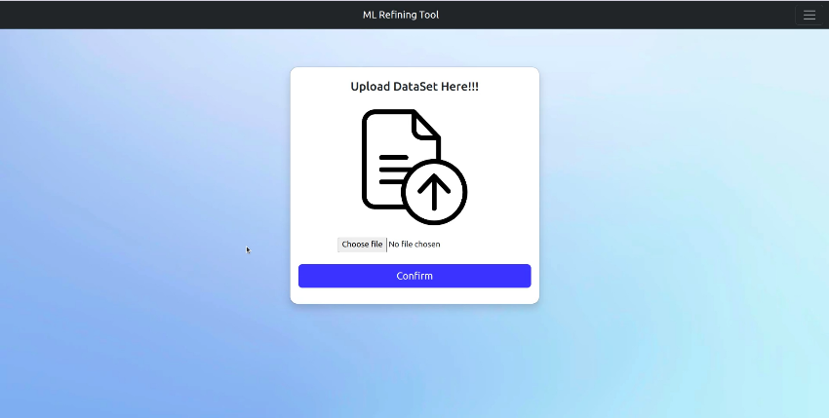
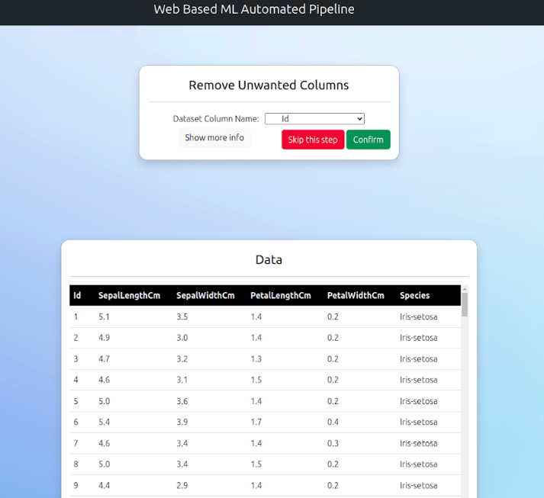
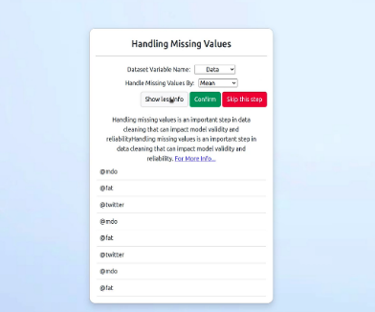
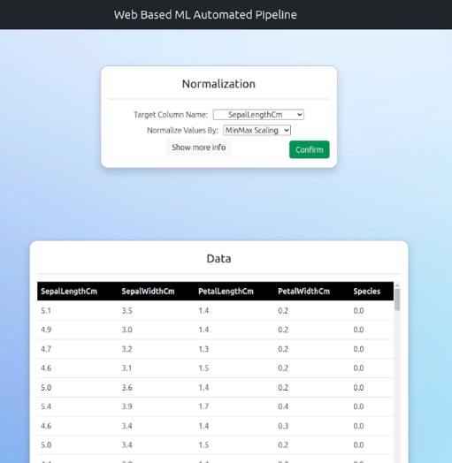
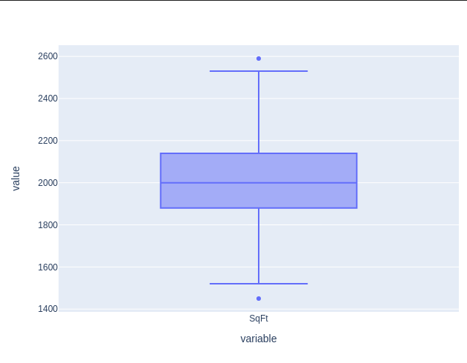
Implementation
Dataset Uploading UI
Remove Unwanted Columns
Handling Missing Values
Outliers
Normalization

Slide 9
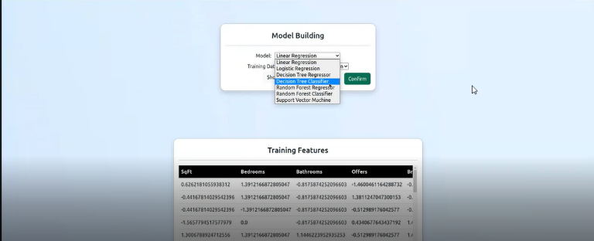
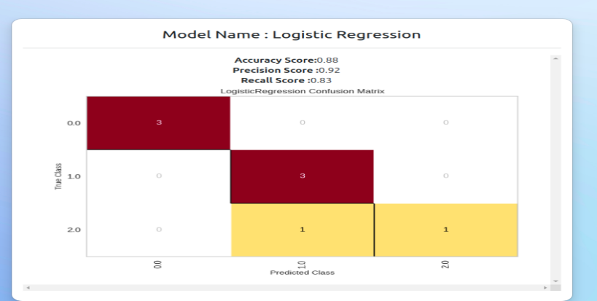
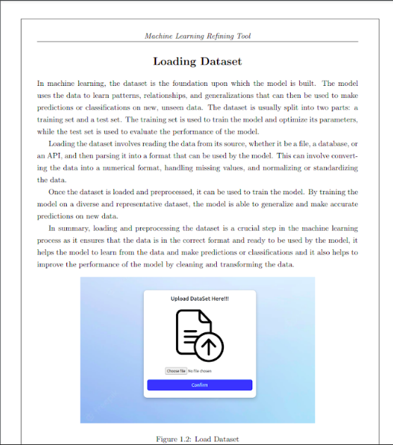
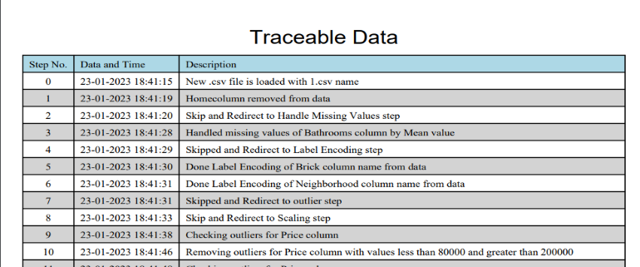
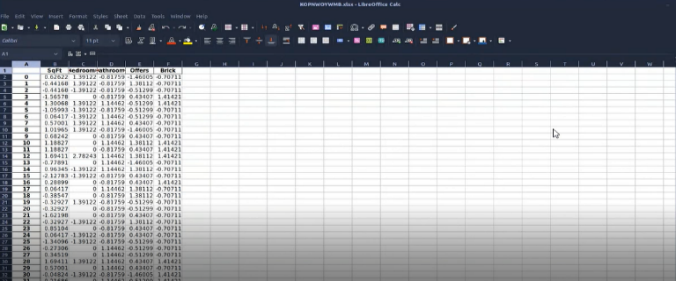
Result
Model Building
Model output
Static Pdf
Tracable pdf
Csv Output data

Slide 10
Conclusion
As the project proceeds it will enhance the visualization of dataset in efficient manner .
Throughout request response cycle the dataset Integrity , consistency is maintained
Providing essential feature which will be easily used while analyzing dataset and provide meaningful information

Slide 11
Thank You!!!

